Slide 1
It’s Getting Hot in Here

Slide 2
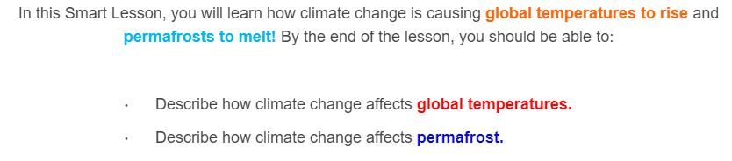
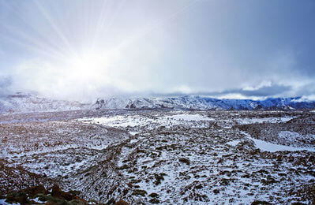

Slide 3
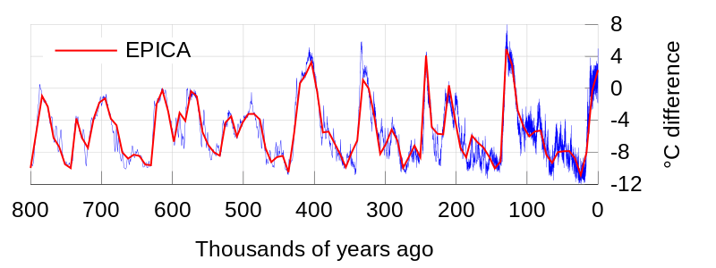
Global temperatures naturally change over very large periods of time, typically hundreds of thousands of years.
This graph shows global temperatures varying over 800 thousand years. At times, they have been as much as 12∘C colder!

Slide 4
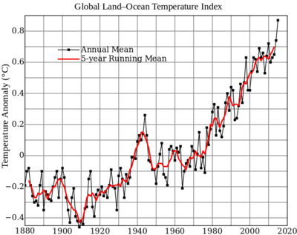
The changes in global temperature that we are currently seeing are occurring much faster than usual. The scientific consensus is that this is partly due to human activity.
This graph compares the average temperature each year to the average temperature for 1951−1980.

Slide 5
The temperature anomaly is the comparison between an individual year's average temperature and a standard reference temperature. In this case, the reference is the average temperature for 1951−1980.

Slide 6
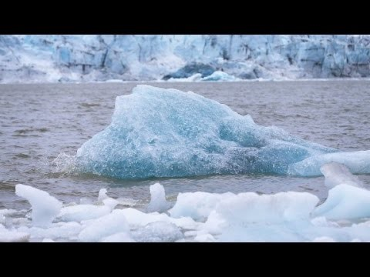

Slide 7

It is worth remembering that experiencing a single hottest year is not a sign of global warming.
However, consistently experiencing new hottest years is a sign of global warming.
A single hottest year might be an anomaly, but 16 out of 17 years is a trend.

Slide 8
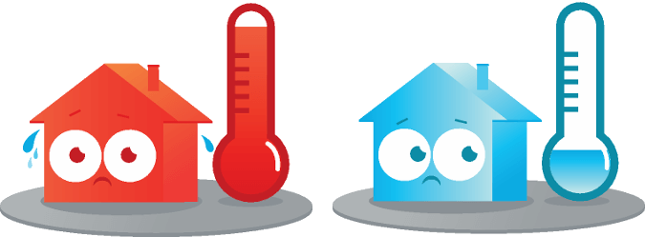
The global temperature is the average temperature of the whole world.
This means that it can get colder in some parts of the world, it will just get even warmer in other parts.

Slide 9
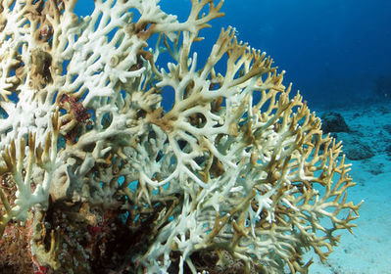
Many species of plant and animal are highly sensitive to temperature, therefore rising global temperatures can lead to their extinction.
Increasing temperatures also have many other effects, such as melting ice caps, causing coral bleaching, increasing the severity of storms and destroying sea meadows!

Slide 10
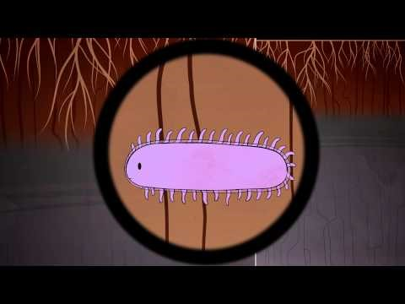

Slide 11
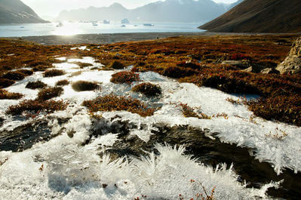
Permafrost is soil that stays frozen for very long periods of time. Over thousands of years, greenhouse gases can be trapped as it forms and are released when it melts.

Slide 12
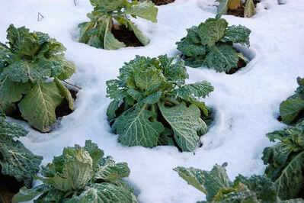
Permafrost forms when global temperatures are cold, and melts when they are warm.
This means that permafrost can be a carbon sink, or a carbon source, depending on the global temperature.

Slide 13
By definition, permafrost is soil which has been frozen for two or more years. Most of the earth's permafrost is located around the Arctic and Antarctic regions.
Permafrost exists in 24% of the exposed land (not covered in ice) in the Northern Hemisphere!

Slide 14
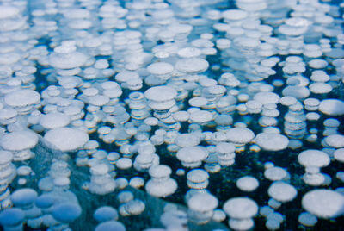
Permafrost contains trapped animal and plant material. If rising temperatures thaw this permafrost, microbes resume decomposing this trapped material and huge amounts of methane gas and carbon dioxide would be released into the atmosphere.
Additionally, microbes that have been trapped beneath the ice could be released, bringing ancient diseases back into the world.
There are already vast bubbles of methane trapped in permafrost, from slow anaerobic (oxygen-free) decomposition.

Slide 15
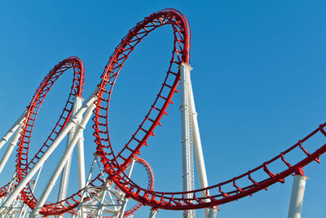
Methane and carbon dioxide are greenhouse gases, which means that releasing them will heat the Earth. This heating will thaw the permafrost faster and release more greenhouse gases. This is known as a positive feedback loop.
It is estimated that permafrost contains as much as 1672 billion tonnes of carbon! This is almost double that of the carbon in the atmosphere.

